Slide 1
WP 7 - Sustainability
30th September, 2020
CERIC-ERIC, ELI, ESRF, ESS, ILL, XFEL.EU

Slide 2
Following steps
7.3 - Business models for Photon and Neutron EOSC – May 2022
Development of advanced business and funding models in connection with Industrial Liaison Offices of each facility, the user communities and all the relevant industrial and research community EOSC stakeholders
HOW:
Use of business model canvas
7.4 - Sustainability plan for the Photon and Neutron EOSC –July 2020 to November 2022
Development of a formal long-term mission and vision for the sustainability of the PaNOSC infrastructure and software developed taking into account the viewpoints of the different stakeholders
HOW:
With the outputs of 7.3, surveys

Slide 3
Following steps
7.3 - Business models for Photon and Neutron EOSC – May 2022
Business model canvas:
A design canvas is a pre-formatted sheet of paper that enables a group of people to work and think together, as well as having structured conversations around a series of key topics to ultimately produce a shared
vision and rich knowledge output.
Roberto’s canvas approach
EOSC Hub’s approach
We can merge these two, adapting the templates to our needs

Slide 4
Following steps
7.3 - Business models for Photon and Neutron EOSC – May 2022
Business model canvas:
A design canvas is a pre-formatted sheet of paper that enables a group of people to work and think together, as well as having structured conversations around a series of key topics to ultimately produce a shared
vision and rich knowledge output.
Roberto’s canvas approach
EOSC Pillar’s approach
We can merge these two, adapting the templates to our needs

Slide 5
Business Model Canvas (Roberto’s approach):
Key Partners:
What are the key partners we need to run the PaNOSC? EOSC? …
Key Activities:
What are the key activities needed to maintain and evolve the PaNOSC?
Value Proposition:
What is the value proposition of PaNOSC? What the services offered?
Customer Relationships:
How will we manage the relationship with PaNOSC users?
Customer Segments:
Who are the users of the PaNOSC?
Key Resources:
What are the key resources needed to run the key activities?
Channels:
What are the channels we will use to promote the PaNOSC? Web? Conferences?
Cost Structure:
What are the cost of maintaining and evolving the PaNOSC? Infrastructures, People, …
Revenue Streams:
What are if any the revenue streams? More publications? What is the economic value of one more publication?

Slide 6
Business Model Canvas EOSC Pillar’s approach:
https://platformdesigntoolkit.com/
The Step by Step process:
Mapping the Ecosystem (stakeholder analysis)
Portraying Ecosystem’s Entities-Roles
Analyzing the Motivations to Exchange Value
Choosing the Core Relationships you want to Focus on
Identifying Elementary Transactions & Channels
Designing the Learning Engine
Assembling Platform Experiences
Setting up the Minimum Viable Platform

Slide 7
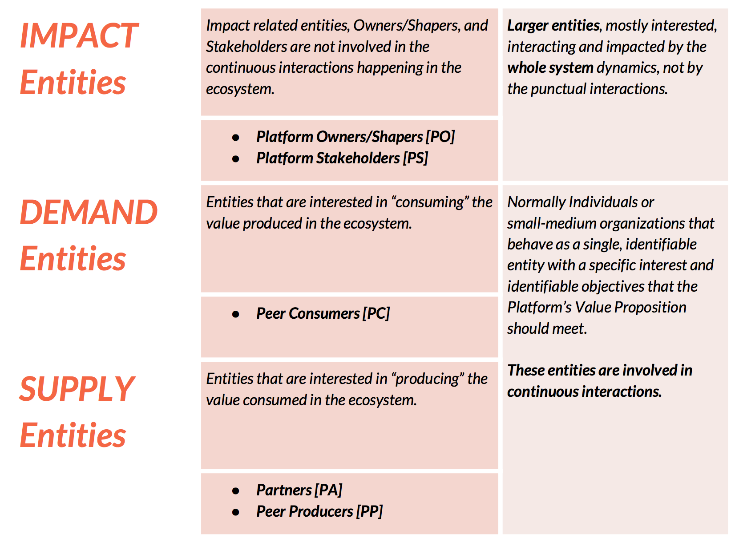
Business Model Canvas EOSC Pillar’s approach: an example (mapping the ecosystem)

Slide 8
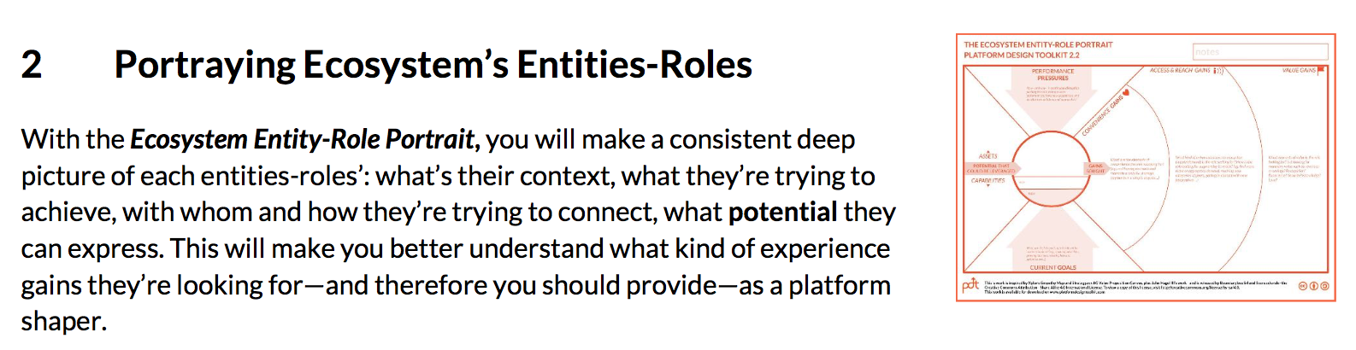
Business Model Canvas EOSC Pillar’s approach: an example

Slide 9
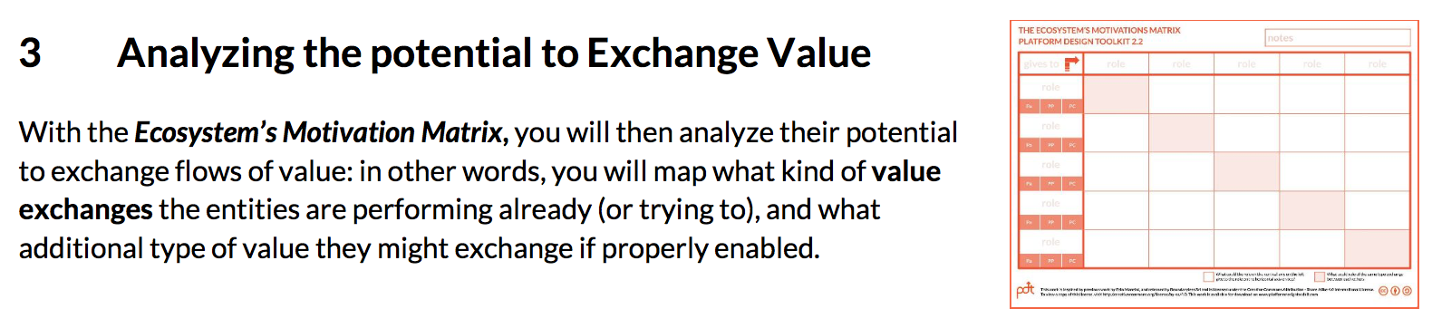
Business Model Canvas EOSC Pillar’s approach: an example

